Slide 1
Types of Questions from DeadLock

Slide 2

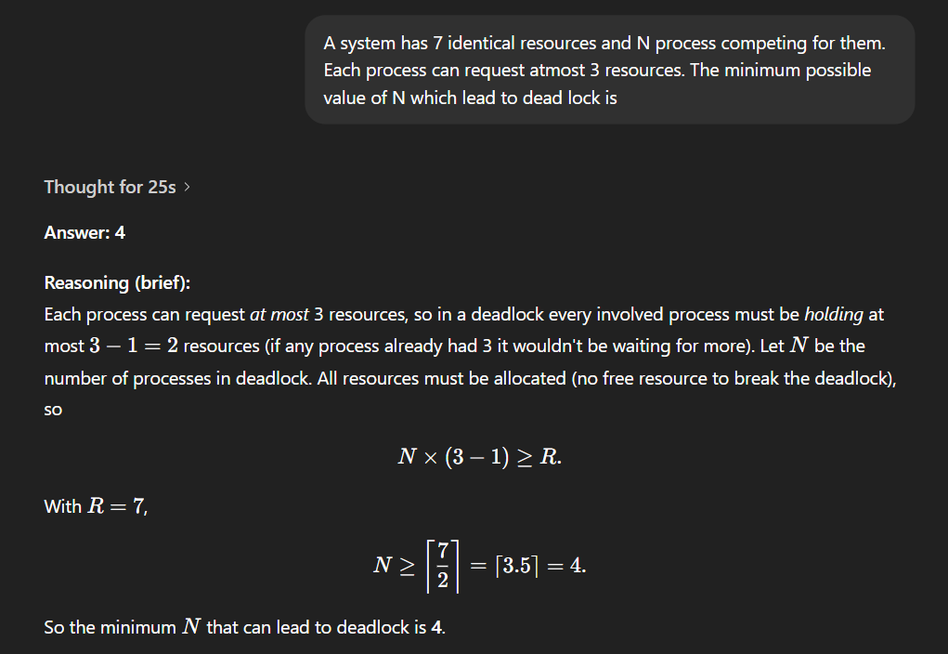
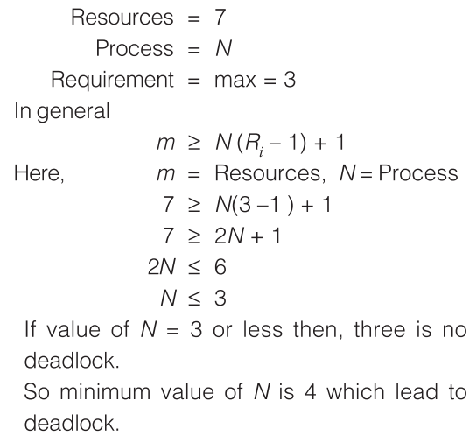

Slide 3
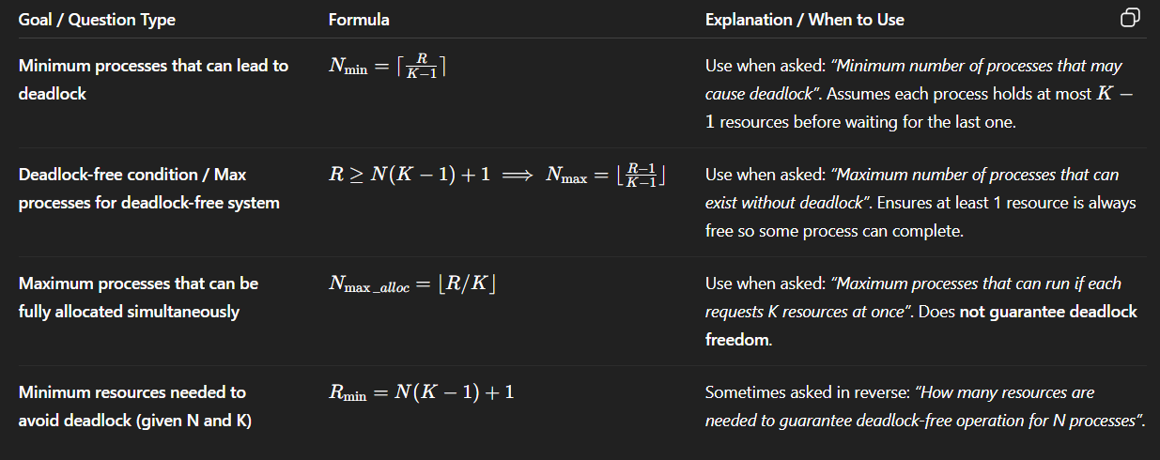
Universal Formula : R = N ( K - 1 ) + 1

Slide 4
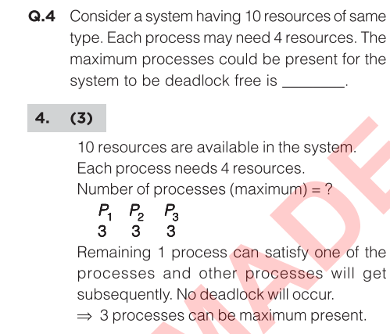

Slide 5
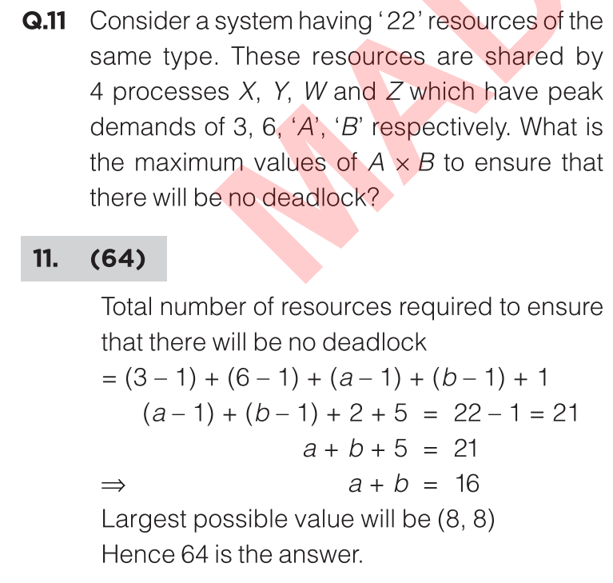

Slide 6
Thank You

